Slide 1
GEST483 IT Governance - IT Value Management -

Slide 2
IT Value Management
What IT value ?
Where are the IT costs ?
How to decide to invest in IT ?
How to charge IT costs to clients ?
Notes:
2
2

Slide 3
IT Value Management
What IT value ?
Where are the IT costs ?
How to decide to invest in IT ?
How to charge IT costs to clients ?
Notes:
3
3

Slide 4
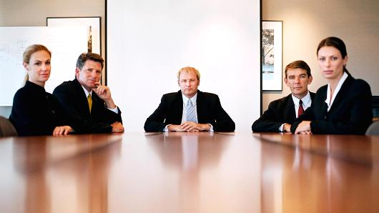
IT Value
- It all started with a question from the Board …. -
Dear CIO colleague, we hear a lot about IT costs ….
Could we discuss the value of IT ?
Notes:
4
4

Slide 5
IT Value - Value …. What value ? -
“Ultimately, IT only has value if it has value to the business. But demonstrating that value to business leaders to have meaningful conversation about what IT actually achieves has historically been a dark art”
“Many Business managers don’t understand IT costs, but explaining them can help forge true partnership between IT and the Business”

Slide 6
IT Value
- Connecting to Strategy and linked down to assets -
Notes:
6
6

Slide 7
IT Value
- Avoiding the ‘disconnect’ -
Filtered information
Selective hearing
Wishful thinking
Fear
Emotional overinvestment
Unrealistic expectations
Notes:
7
7

Slide 8
IT Value
- Setting up the right framework -
Notes:
8
8

Slide 9
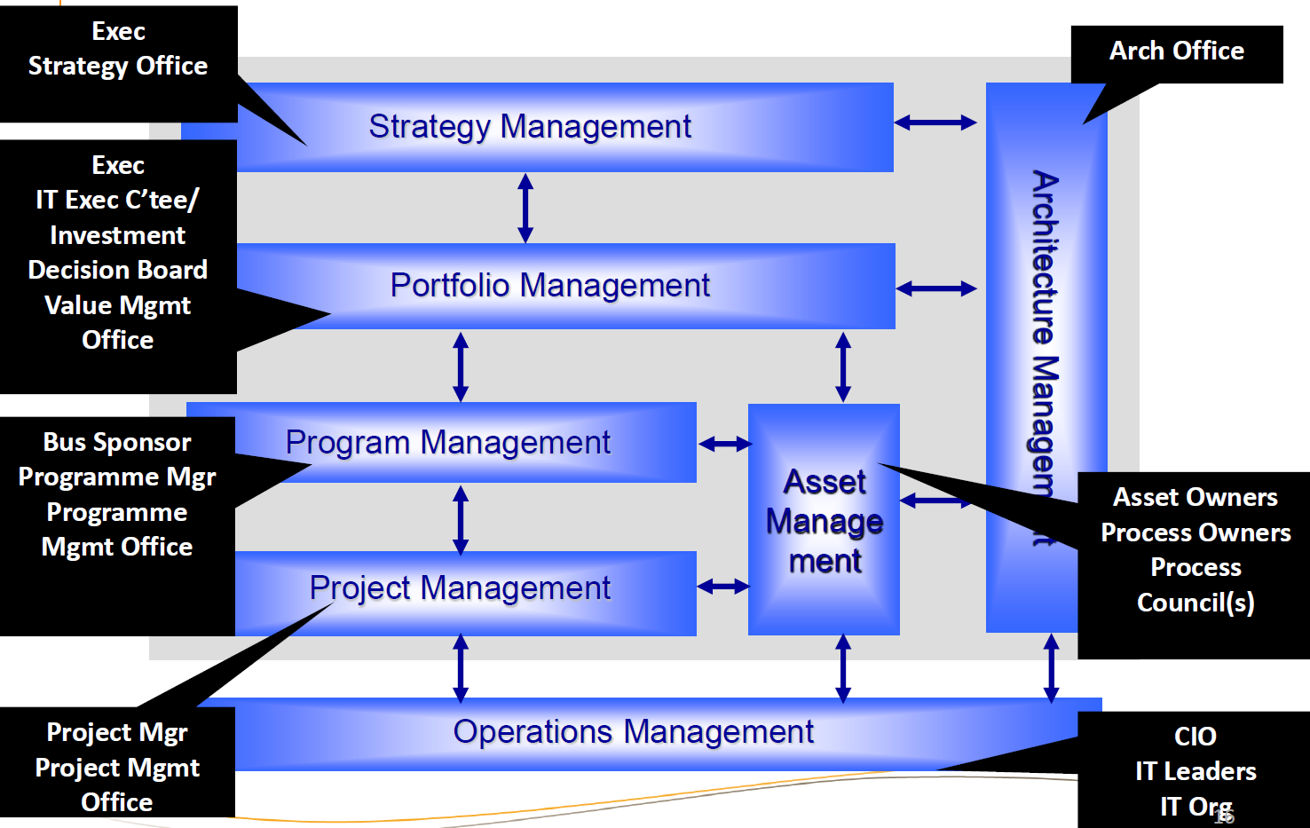
IT Value
- And deploying the right governance -
??
Notes:
9
9

Slide 10
IT Value
- Val IT as a useful framework -
Notes:
10
10

Slide 11
IT Value
- To increase IT value contribution to the company -
Notes:
11
11

Slide 12



IT Value
- Allowing CIO to focus on clear goals -
Business
Add Value
Investment Planning
Insight into the cost of service
Avoid Costs
Reduce Costs
CIO
Ability to forecast accurately
Efficient
asset utilization
Source: Hewlett-Packard
Notes:
12
12

Slide 13
IT Value Management
What IT value ?
Where are the IT costs ?
How to decide to invest in IT ?
How to charge IT costs to clients ?
Notes:
13
13

Slide 14

IT costs - Where is the money ? -
 | People (Workforce) | Software (Applications) | Hardware (Infrastucture)
Acquire (Forecasting + Budgeting)
Maintain (Accouting + recharging)
3 main IT cost components
and …
2 main decision moments

Slide 15
IT costs - Main questions when acquiring resources -
 | People (Workforce) | Software (Applications) | Hardware (Infrastucture)
Acquire (Forecasting + Budgeting)
Maintain (Accouting + recharging)
Acquire = Increase cost => What business case ?
Sourcing = Impact on P&L / BS => What sourcing strategy ?
Balance = Allocation of budget => What balance between ‘Change’ & ‘Run’ cost to meet regulatory, internal, business, ….. needs

Slide 16
IT costs - Main questions when maintaining resources -
 | People (Workforce) | Software (Applications) | Hardware (Infrastucture)
Acquire (Forecasting + Budgeting)
Maintain (Accouting + recharging)
Monitor costs => What cost control mechanisms ?
Rebill => How to recharge real & fair costs to users ?
Des-invest => How to get rid of poorly used / too expensive products/services ?

Slide 17
IT Value Management
What IT value ?
Where are the IT costs ?
How to decide to invest in IT ?
How to charge IT costs to clients ?
Notes:
17
17

Slide 18
Building Business Cases
- The key questions -
Notes:
18
18

Slide 19
Building Business Cases
- The key questions -
Notes:
19
19

Slide 20
Building Business Cases
- Positioning as part of managing value -
Notes:
20
20

Slide 21
Building Business Cases
- What should be in ? -
Notes:
21
21

Slide 22
Building Business Cases
- A practical guide in 8 steps -
Notes:
22
22

Slide 23
Building Business Cases
- A practical guide in 8 steps -
Notes:
23
23

Slide 24
Building Business Cases
- A practical guide in 8 steps -
Notes:
24
24

Slide 25
Building Business Cases
- A practical guide in 8 steps -
Notes:
25
25

Slide 26
Building Business Cases
- A practical guide in 8 steps -
Notes:
26
26

Slide 27
Building Business Cases
- A practical guide in 8 steps -
Notes:
27
27

Slide 28
Building Business Cases
- A practical guide in 8 steps -
Notes:
28
28

Slide 29
Building Business Cases
- A practical guide in 8 steps -
Notes:
29
29

Slide 30
Building Business Cases
- A practical guide in 8 steps -
Notes:
30
30

Slide 31
IT Value Management
What IT value ?
Where are the IT costs ?
How to decide to invest in IT ?
How to charge IT costs to clients ?
Notes:
31
31

Slide 32
Modelling & charging IT costs - Do you know the costs ? -
Do you know the costs of IT services employees use every day?
What would be included in a running cost…?
Of a desktop/laptop
Of a Man Day
Of infrastructure components? Servers, DB, storage,…
Of an application
IT calculates and recharges all its costs to its ‘client’s (internal or external)

Slide 33
Modelling & charging IT costs - What is modelling & recharging ? -
Modelling IT direct and indirect costs based on service definitions
Allow to recharge the clients in function of the consumption
Hence, a Cost Model should be recognized as being fair (reflect consumption) and transparent (provide enough details for general acceptance)
Challenges :
Making sure all Services are modelled
Correctly measuring client consumption of IT services
It should help the clients and IT managers to use resources properly and better manage their Costs

Slide 34
Modelling & charging IT costs - Costs include various elements -
 | Desktop/Laptop | Man Day | Infrastructure components | Application
Direct Costs | HW cost (leasing or depreciation) SW cost (OS, Office, antivirus,…) | Wage | HW cost (leasing or depreciation) SW cost (OS, monitoring,…)
 | Support (e.g. SW deployment, User support Centre) | Training costs | Support (e.g. staging, security patches,…) | Maintenance of the application
 | Underlying infrastructure (access management, NW connection,…) | Work environment (development tools, desktop,…) | Underlying infrastructure (access management, NW connection,…) | Underlying infrastructure (servers, DB, storage,…)
 | Transversal processes, Management, reporting | Transversal processes, Management,… | Transversal processes, Management, reporting, monitoring | Transversal processes, Management, reporting, monitoring
Indirect Costs | Facilities cost, HR costs,… (of people that support the service) | Facilities cost, HR costs,… | Facilities costs (DC, power, cooling), HR Costs | Facilities costs (DC, power, cooling), HR Costs

Slide 35





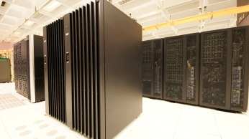
Modelling & charging IT costs - Defining your services and knowing your clients -
The Services that an IT department can offer:
IT department’s Clients:
Any internal department or external company that is using IT Services
Application internally developped and hosted on servers located in a Data Centre owned by the Company
Applicative IT Services
Desktop, laptop, phone, smartphone, printers,…
End User Services
Infrastructure components that host applications
Development of an application (internally)
Application Development
Hosting Services
Room in a Data Centre
Housing Services

Slide 36
Modelling & charging IT costs - Budget Management VS Cost Management -
Budget
Cost Model
Services
Accounting
P&L
Direct and indirect Cost
100% accurate
Approximation (80-20 rule)
Total Cost
IT Volumes & €
Representative
Measurable
Unit Prices

Slide 37


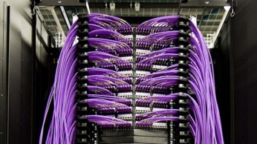
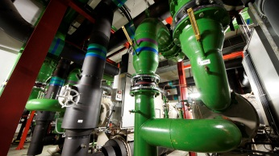
Modelling & charging IT costs - Modeling: From Assets to Services …. -
Budget
Cost Model
Services
Assets
Services
Hardware and Software cost
Resources
Managed Services
Transversal cost
Facilities
Bundled Services with transparent description and Unit Prices
(no matter which sourcing
strategy is applied)

Slide 38
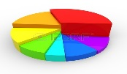


Modelling & charging IT costs - Recharging: From Services to Clients -
Services
Clients
Cost of Services
Total Volumes
Unit price
Volumes * Unit Prices
Allocation per Client and Reporting
Bundled Services with transparent description and Unit Prices
Allocation / Invoice
Reporting on consumption
Cost Decision and Analysis
€

Slide 39

Modelling & charging IT costs - Recap key elements of IT cost modelling -
Budget
Cost Model
Services
Budget
Services
Resources
IT
Direct
VAT
FAC
HR
Indirect

Slide 40
Modelling & charging IT costs - Links with other IT processes -
Demand Mngt
Service CatalogueMngt
Business Relationship Mngt
Capacity Mngt
Volume prediction based on new initiatives
Service Definition and description
Cost Modelling
Based on consumption measurement
Report to clients
Predictive volume and recharging negotiation
Volume based on clients forecast

Slide 41
Key take aways in a nutshell
IT Value
IT only has value if it has value to the business.
Connect IT investments with Company strategy by setting up the right framework and associated governance. Val IT as a useful framework to increase IT contribution to the company
IT Costs
3 main components: people, software, hardware where ‘acquisition’ and ‘maintenance’ moments trigger specific questions for CIOs
IT investment decisions
Business cases should answer 5 main topics: case for change, value for money, commercial viability, affordable investment and successful delivery.
IT Cost modelling & recharging
IT recharges all its costs to its (internal & external) ‘clients / users’. Modelling costs starts from assets to derive cost of services. Recharging fairly reallocates usage of services to ‘clients / users’
Notes:
41
41

Slide 42
At ease now to answer the question ?
Dear CIO colleague, we hear a lot about IT costs ….
Could we discuss the value of IT ?
Notes:
42
42

Slide 43
END

Slide 44
Finance every day Key questions, hot spots & way to address
 | People (Workforce) | Software (Applications) | Hardware (Infrastucture)
Acquire (Forecasting + Budgeting) | Forecast needed staff capacity (who / how much ?) Think about ‘skills’ and ‘heads’ Do a workforce planning Need for ‘Change‘ : Input from business & IT projects Need for 'Run': Input from CIO/CTO. Budget based on ‘Historical FTE’ or Zero-based budgeting (based on drivers of activities) Identify ‘critical resources’ (skills) Secure flexibility of workforce skills and size … => Key practice: Sourcing Management
Maintain (Accouting) | Maintain needed staff capacity Track people time registry (activity-based) Allocate correctly time on ‘projects’ or on 'run‘ Detect and unblock bottlenecks (overcapacity / undercapacity in teams) … => Key practice: Resource Management

Slide 45
Finance every day Key questions, hot spots & way to address (cont’d)
 | People (Workforce) | Software (Applications) | Hardware (Infrastucture)
Acquire (Forecasting + Budgeting) |  | Forecast software needs Make or Buy or Cloud (AaaS)? How to integrate in current architecture ? … => Key practice: Application Development Strategy
Maintain (Accouting) |  | Maintain software needs Track software depreciation / amortisation Plan upgrades (versions / releases) Review code to optimise performance / lower data consumption Decommission unused apps or apps with low use … => Key practice: Application Development Strategy

Slide 46
Finance every day Key questions, hot spots & way to address (cont’d)
 | People (Workforce) | Software (Applications) | Hardware (Infrastucture)
Acquire (Forecasting + Budgeting) |  |  | Forecast infrastructure needs Used capacity by asset (main infra component / asset) ? Forecasted capacity (trending / forecast based on business volumes) ? Increased capacity needed by new assets (projects) ? Lease or Buy or Cloud (IaaS)? … => Key practice: Infrastructure Management Strategy
Maintain (Accouting) |  |  | Maintain infrastructure needs Track infra depreciation / amortisation (Re)-Allocate infra capacity used by service / business Reallocate infra capacity (virtualisation) Decommission infra assets … => Key practice: Infrastructure Management Strategy

Slide 47
Cockpit View
- Step 1: Zoom on your scope -
Identify the measures that allow you drive where you want to go !
Ambition
The corporate’s value proposition on the long run (3-5 years)
The short to medium term (1-3 years) target supporting the ambition
The goals for this year (1 year)
Eg:
Achieve in year ‘Y+3’ a market share of ‘x%’ for product ‘P’ in country ‘C’
Launch in year ‘Y+1’ a digital offering of product ‘P’ in country ‘C’
Go life in year ‘Y’ with a digital offering of product ‘P’
Strategy
Eg:
Objectives
Eg:
47
Notes:
47
47

Slide 48
Cockpit View
- Step 3: Build the dashboard -
Customers
# customer complaints (split per category of products)
Customer satisfaction scores
…
# incidents (split per priority / category)
Availability of critical applications & channels (%)
…
# functional points delivered
Main exception reports (scope variance, budget overspent)
Overall calendar and RAG view of projects
…
Cost evolution per funding type (Eur)
Budget VS Actuals per department
…
# recommentations (audit / regulators) closed / to close by year end
# applications for which Disaster Recovery exercises have been tested
…
Evolution of absenteeism per department (# days)
People Motivation Barometer (scores/category)
…
Op. Quality
Delivery
Costs
Risks
People
Notes:
48
48

Slide 49
Cockpit View
- Step 4: Communicate / Discuss / Act -
Dashboard
=/= Indicators
=
Indicators (figures)
+ Macro Action Plan
+ Issue board
Your dashboard is only worth the actions it enables
To enable actions, dashboards should be ‘public’ and subject to discussions with the teams in charge (all stakeholders)
Corrective actions to achieve targets should be registered and reviewed in the next team discussion
Try weekly or daily ‘Stand Up Cockpit Meetings’
(works well in Scrum practice ….)
“Cockpit meetings are regular meetings to systematically and continuously improve performance towards objectives and to make sure that tasks and deliveries run according to agreed schedule”
“Cockpit meetings at team level create a PACT between the manager and his team, a system that enables delegation and trust”
Notes:
49
49

